Slide 1
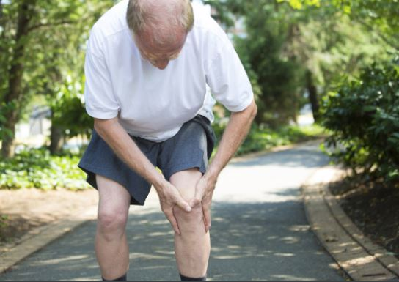
University of Basrah
College of Nursing
Fundamentals of Nursing Department
Second stage
Adult Nursing (II) 2nd Stage
Lecture 1 (Theory)
Arthritis
Dr. Mohamad Abdulridha
Orthopedic Surgeon
M.B.CH.B F.I.C.M.S (ORTHO)

Slide 2
Causes of arthritis
Injury (leading to osteoarthritis).
Metabolic abnormalities (such as gout and pseudogout).
Hereditary factors.
The direct and indirect effect of infections (bacterial and viral) septic joint
Misdirected immune system with autoimmunity (such as in rheumatoid arthritis and systemic lupus erythematosus).

Slide 3
Types and symptoms of arthritis
Types of arthritis | Symptoms
Osteoarthritis | pain in a joint, stiff, and tenderness when pressure is applied to the joint. The patient may find it harder to use the joint . lumps, or bone spurs may appear around the joint. In some cases the joint might swell. The most common affected joints are in the hips, hands, knees and spine.

Slide 4
Rheumatoid arthritis | 1.Symptoms are usually worst on waking up in the morning and the stiffness can last for 30 minutes at this time. 2.The joint is tender when touched. 3. Hands may be red and puffy. 4. There may be rheumatoid nodules (bumps of tissue under the skin of the patient's arms). 5.Many patients with rheumatoid arthritis feel tired most of the time 6. Weight loss is common.
Infectious arthritis | 1. fever, joint inflammation and swelling. 2.tenderness and/or a sharp pain. 3. Often these symptoms are linked to an injury , surgery or another illness. 4. Most commonly affected areas are the knee, shoulder, elbow, wrist and finger.

Slide 5
Juvenile rheumatoid arthritis | 1. The patient is a child. 2. intermittent fevers which tend to peak in the evening and then suddenly disappear. 3. poor appetite and lose weight. 4 There may be blotchy rashes on his arms and legs. 5. Anemia is also common. 6. A joint may suddenly swell and stay larger than it usually is. 7.The child may experience a stiff neck, hips or some other joint.

Slide 6
Rheumatoid arthritis

Slide 11
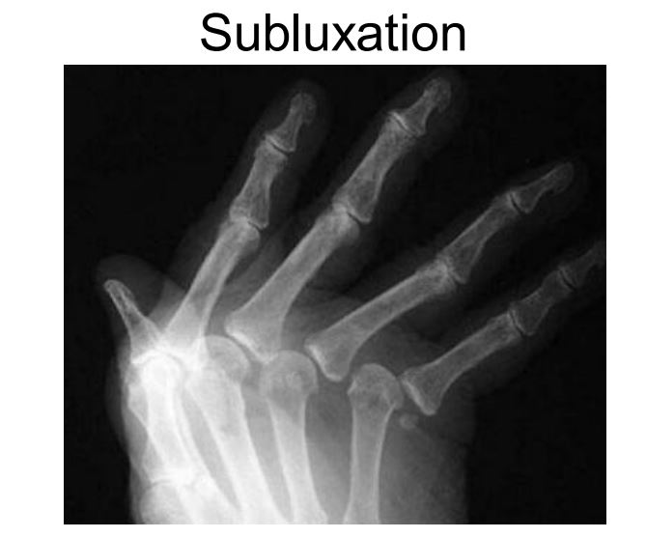

Slide 25
Osteoarthritis
Osteoarthritis is a non-inflammatory, degenerative condition of joints Characterized by degeneration of articular cartilage and formation of new bone i.e. osteophytes.

Slide 26
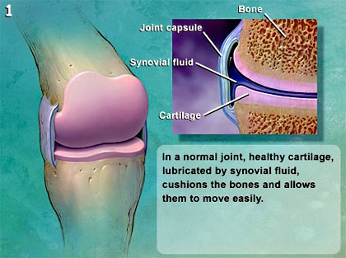
PATHOLOGY
At the earliest stages of osteoarthritis, your joints look like this:

Slide 27
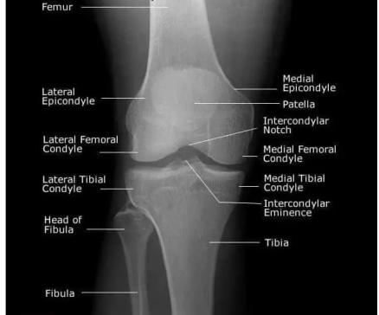
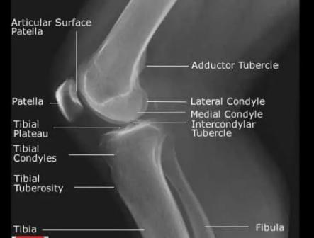
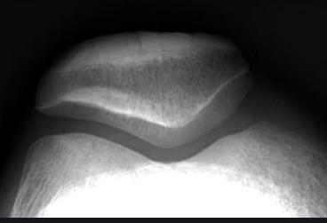

Slide 28
As your osteoarthritis progresses, it looks like this:

Slide 29
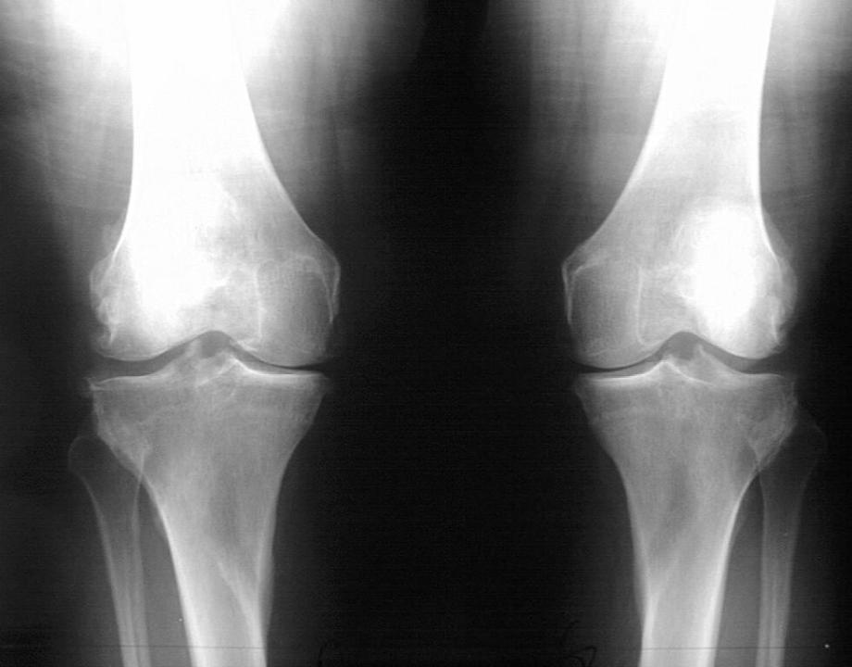

Slide 30
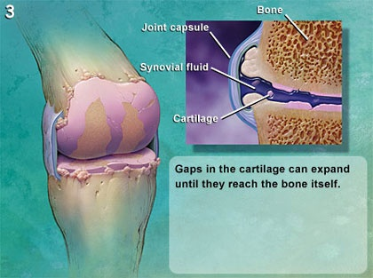
Advancing osteoarthritis looks like this:

Slide 31
Patients with this level of osteoarthritis usually have pain most of the time:

Slide 32
This is the end stage of disease. Note that there is no cartilage left on the end of the bone:

Slide 33
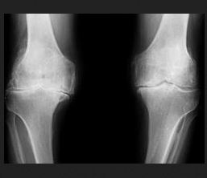

Slide 34
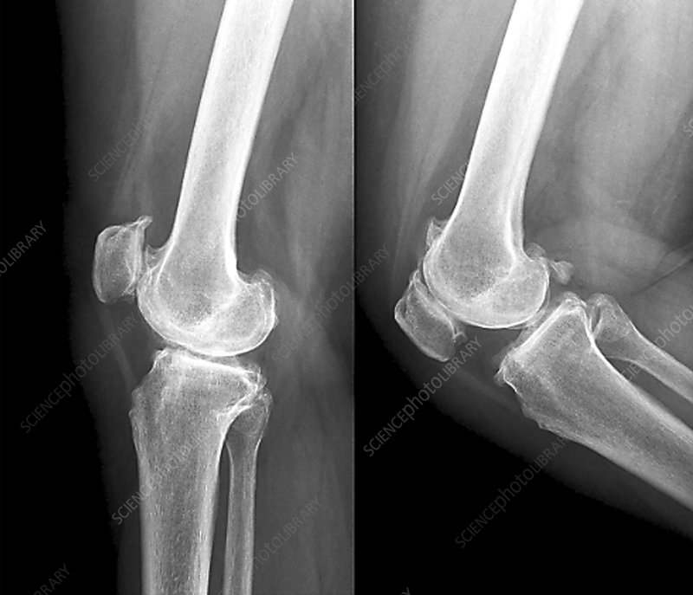

Slide 35
Symptoms
Osteoarthritis symptoms often develop slowly and worsen over time. Signs and symptoms of osteoarthritis include:
· Pain in a joint during or after use, or after a period of inactivity
· Tenderness in the joint when you apply light pressure
· Stiffness in a joint, that may be most noticeable when patient wake up in the morning or after a period of inactivity
· Loss of flexibility may make it difficult to use the joint
· Grating sensation when moving the joint
· Bone spurs, which appear as hard lumps, may form around the affected joint
· Swelling in some cases
Deformities
Osteoarthritis symptoms most commonly affect the hands, hips, knees and spine. Unless one has been injured or placed unusual stress on a joint, it's uncommon for osteoarthritis symptoms to affect jaw, shoulder, elbows, wrists or ankles.

Slide 38
Risk factors
Factors that increase risk of osteoarthritis include:
· Older age. Osteoarthritis typically occurs in older adults. People under 40 rarely experience osteoarthritis.
· Sex. Women are more likely to develop osteoarthritis, though it isn't clear why.
· Bone deformities. Some people are born with malformed joints or defective cartilage, which can increase the risk of osteoarthritis.
· Joint injuries. Injuries, such as those that occur when playing sports or from an accident, may increase the risk of osteoarthritis.
· Obesity. Carrying more body weight places more stress on weight-bearing joints, such as knees. But obesity has also been linked to an increased risk of osteoarthritis in the hands, as well.
· Other diseases that affect the bones and joints. Bone and joint diseases that increase the risk of osteoarthritis include gout, rheumatoid arthritis, Paget's disease of bone and septic arthritis.

Slide 39
Tests and diagnosis
History & Clinical examination
· X-rays. X-ray images of the affected joint may reveal a narrowing space within a joint, which indicates that the cartilage is breaking down. An X-ray may also show bone spurs around a joint.
· Blood tests. Blood tests may help rule out other causes of joint pain, such as rheumatoid arthritis.
· Joint fluid analysis. Examining and testing the synovial fluid can determine if pain is caused by gout or an infection.
· Arthroscopy. In some cases, arthroscopy to see inside the joint in order to determine the cause of pain. During arthroscopy, small incisions are made around the joint and a tiny camera is inserted to see inside the joint

Slide 40
Treatment
There's no known cure for osteoarthritis, but treatments can help to reduce pain and maintain joint movement so that patient can go about his daily tasks. While medications and joint replacement surgery are key components of treatment for osteoarthritis, doctor will likely recommend to try all other possible solutions before one can consider those options. Eventually the pain may become severe so that medications and eventually surgery may become necessary.

Slide 42
Initial treatment options for mild osteoarthritis
Rest. for 12 to 24 hours. Find activities that don't require use joint repetitively.
Exercise. regular exercise, Stick to gentle exercises, such as walking, biking or swimming. Exercise can strengthen the muscles around joint, making it more stable.
Weight reduction. Being overweight or obese increases the stress on weight-bearing joints, knees and hips. Even a small amount of weight loss can relieve some pressure and reduce pain.
Heat and cold to manage pain. Heat also relieves stiffness and cold can relieve muscle spasms.
Work with a physical therapist.
Walking aids
Find ways to avoid stressing joints.
Apply over-the-counter pain creams.
Consider trying special splints, braces, shoe inserts or other medical devices that can help reduce pain.
Chronic pain class. These classes teach skills that help to manage osteoarthritis pain. And patient will meet other people with osteoarthritis and learn their tips for reducing joint pain .

Slide 43
Treatment options for moderate osteoarthritis
Osteoarthritis pain that persists despite initial treatment may require medications in addition to initial treatment options. In order to get the most from treatment, continue exercising when possible and rest when needed. If overweight, continue weight loss .
Medications that may be useful for moderate arthritis include:
· Acetaminophen. relieve pain, but doesn't reduce inflammation. It has been shown to be effective for people with osteoarthritis who have mild to moderate pain.
· NSAIDs. can relieve pain and reduce inflammation. Ibuprofen, naproxen , and others. NSAIDs have risks of side effects that increase when used at high dosages for long-term treatment. Side effects may include gastric ulcers, cardiovascular problems, gastrointestinal bleeding, and liver and kidney damage.
· Tramadol. is a centrally acting analgesic that has no anti-inflammatory effect, but can provide effective pain relief with fewer side effects - such as stomach ulcers and bleeding - than those of NSAIDs. However, tramadol may cause nausea and constipation. It's generally used for short-term treatment of acute flare-ups.

Slide 44
Treatment options for severe osteoarthritis
If you've tried other treatments but your patient still experiencing severe pain and disability, you and your patient can discuss other treatments including:
· Stronger painkillers. such as codeine and propoxyphene may provide relief from more severe osteoarthritis pain. These stronger medications carry a risk of dependence,
· Cortisone shots. Injections of corticosteroid medications may relieve pain in joint. It isn't clear how or why corticosteroid injections work in people with osteoarthritis. too many corticosteroid injections may cause joint damage.
· Visco-supplementation. Injections of hyaluronic acid derivatives may offer pain relief by providing some cushioning in the joint . Injections are typically given weekly over several weeks or once a year. Pain relief may last for a few months. Possible risks include infection, swelling and joint pain.

Slide 45
Surgery for osteoarthritis
Surgery is generally reserved for severe osteoarthritis that isn't relieved by other treatments. Surgical treatments include: .
· Debridement ,is most useful in cases with a locking sensation from a torn cartilage or loose debris Debridement is typically done arthroscopically,
· Fusing bones. Surgeons also can permanently fuse bones in a joint (arthrodesis) to increase stability and reduce pain. The fused joint, such as an ankle, can then bear weight without pain, but has no flexibility.
Realigning bones. Surgery to realign bones may relieve pain. These types of procedures are typically used when joint replacement surgery isn't an option, such as in younger people with osteoarthritis. During a procedure called an osteotomy, the surgeon cuts across the bone either above or below the knee to realign the leg.
Joint replacement. In joint replacement surgery (arthroplasty), surgeon removes damaged joint surfaces and replaces them with plastic and metal devices called prostheses. Joint replacement surgery can help patients resume an active, pain-free lifestyle. Joint replacement surgery carries a small risk of infection and bleeding. Artificial joints can wear or come loose, and may need to eventually be replaced

Slide 46
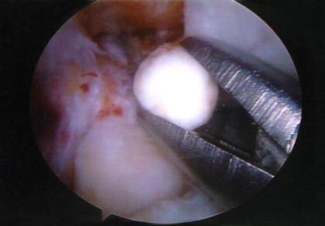
Arthroscopy- joint debridement to remove interfering osteophyte, cartilage tags and loose bodies
may provide temporary
relief from symptoms
but does not stop the
progression of OA
Arthroscopic view of the removal of cartilaginous loose body.

Slide 47
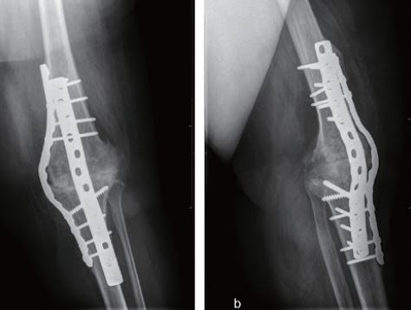
Knee arthrodesis

Slide 48
Principle: To redistribute loading forces towards less damaged parts of the joint
e.g to shift weight from the damaged cartilage on the medial aspect of the knee to the healthy lateral aspect of the knee

Slide 49
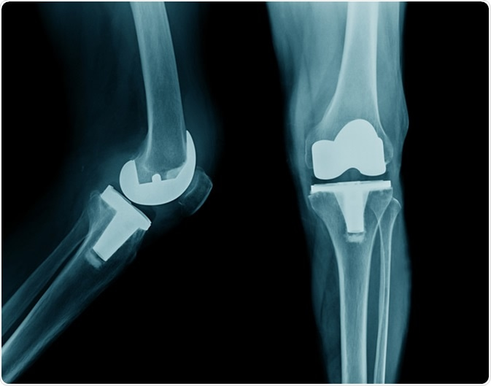
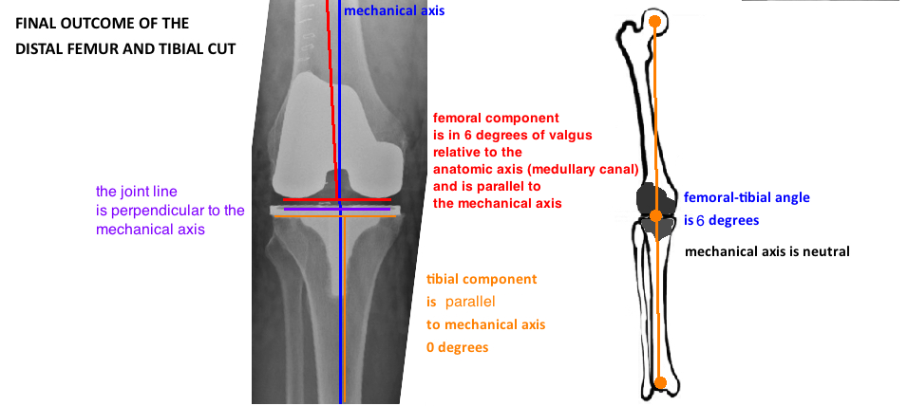

Slide 50
Summary
1. Causes of arthritis
2.Know type of Arthritis
3. General outline in management of arthritis

Slide 51
Question
In rheumatic arthritis patients, at an early stage, the active inflammation in the joint occurs as: A. Lymph node enlargement
B. Limitation in function
C. Deformity of joints
D. Immobilization of extremity
E. Muscle atrophy

Slide 52
Question
Which of the following would be the most significant early symptoms that should be assessed by the nurse when a patient reports the onset of symptoms of rheumatoid arthritis?
A. Limited motion of joint.
B. Deformed joints of the hand.
C. Early morning stiffness.
D. Rheumatoid nodule.
E. Muscle cramps.

Slide 53
Question
Hands and feet deformities of patients with rheumatoid arthritis are common resulting from: A. Pain
B. Limited movement
C. Joint swelling
D. Fatigue
E. Numbness

Slide 54
Question
Arthritis initially begins in which of the following joints? A. Elbow
B. Hips
C. Shoulder
D. Knee
E. Finger

Slide 55
Question
A nurse is assessing a patient for risk factors known to contribute to osteoarthritis. What assessment finding would the nurse interpret as a risk factor?
A) The patient has a 30 pack-year smoking history. B) The patients body mass index is 34 (obese). C) The patient has primary hypertension. D) The patient is 58 years old.

Slide 56
Reference
Textbook of medical-surgical nursing Description: 14th edition. | Philadelphia : Wolters Kluwer, [2018], ISBN 9781496355157 (2-volume American edition)

